Slide 1

Capstone Project – Final: Review – 1 on
Online Payment Fraud Detection
Presented by the Batch No. : CSBS-3
G.AKASH BU21CSEN0200131(TL)
V.JATHIN BU21CSEN0200046
A.SHARAN BU21CSEN0200079
G.MANINDAR BU21CSEN0200168
Under the Guidance of
Mrs.Chandra Prabha
Assistant Professor
Department of Artificial Intelligence & Data Science
GITAM School of Technology, GITAM (Deemed to be University),
Bengaluru, Karnataka, INDIA.

Slide 2
CONTENTS
Abstract
Introduction
Literature Survey
Problem Statement
Objectives
Requirement Analysis
Identification of tools/technology/algorithms
Final Design Strategy (project workflow/ system design/ DFD/UML design)
Status of Implementation
Conclusion
Gantt Chart
References

Slide 3
Abstract
The system first preprocesses transaction data to extract relevant features, followed by the implementation of XGBoost for initial fraud prediction, leveraging its efficiency and robustness in handling imbalanced datasets. Subsequently, the predictions are refined using a DNN, which captures complex patterns in the data. To optimize model parameters and improve accuracy, WOA is employed, inspired by the hunting behavior of whales, to efficiently navigate the solution space.

Slide 4
CONTENTS
Abstract
Introduction
Literature Survey
Problem Statement
Objectives
Requirement Analysis
Identification of tools/technology/algorithms
Final Design Strategy (project workflow/ system design/ DFD/UML design)
Status of Implementation
Conclusion
Gantt Chart
References

Slide 5
Introduction
Online payment fraud detection using XGBoost and DNN with WOA is a method for identifying fraudulent transactions in online payments. It combines XGBoost, a powerful machine learning algorithm, and Deep Neural Networks (DNN) to analyze transaction data. The Whale Optimization Algorithm (WOA) is used to improve the accuracy of these models by optimizing their parameters. Together, this approach enhances the ability to detect and prevent fraudulent activities, ensuring safer online transactions.
Challenges
Complexity: Combining XGBoost, DNN, and WOA into a single model adds complexity in terms of both architecture and computational resources. Computational Cost: Training both XGBoost and DNN models, along with running the Whale Optimization Algorithm, may require significant computational resources, especially if the dataset is large Tuning WOA: WOA itself has parameters (e.g., population size, number of iterations) that need tuning for optimal performance. These must be carefully adjusted to get the best results from the model.

Slide 6
Introduction..contd
XGBoost (Extreme Gradient Boosting) is a highly efficient and scalable implementation of the gradient boosting algorithm. It’s widely used in machine learning for tasks such as classification and regression due to its high performance, flexibility, and ability to handle a wide range of data types.
A DNN (Deep Neural Network) is a type of artificial neural network with multiple layers between the input and output layers. It is called "deep" because it has more than one hidden layer, allowing it to learn complex patterns and features from the data.
The Whale Optimization Algorithm (WOA) is a nature-inspired optimization algorithm that mimics the hunting behavior of humpback whales. It is used to find optimal solutions to complex problems by simulating how whales encircle and trap prey in a bubble-net formation.

Slide 7
CONTENTS
Abstract
Introduction
Literature Survey
Problem Statement
Objectives
Requirement Analysis
Identification of tools/technology/algorithms
Final Design Strategy (project workflow/ system design/ DFD/UML design)
Status of Implementation
Conclusion
Gantt Chart
References

Slide 8
Literature Survey
Table 1: Literature Survey
S.No. | Paper Details | Summary | Techniques/Algorithms Used | Research Gap
1. | Personal loan default prediction and impact analysis of debt/DR raj Gopal April 2023 | It highlights how debt levels influence default risks, emphasizing the importance of early intervention strategies to mitigate financial loss.. | Logistics Regression, SVM | Expand dataset for better generalization

Slide 9
Literature Survey…contd
Table 1: Literature Survey Contd…
S.No. | Paper Details | Summary | Techniques/Algorithms Used | Research Gap
2. | Research on credut risk models via machine learning algorithm and logestic regression for prediction/kera | It compares these models in terms of accuracy and efficiency, highlighting their strengths in identifying potential defaulters and managing financial risks effectively. | Decision trees, XG Boost | Simplifying interface for users

Slide 10
Literature Survey…contd
Table 1: Literature Survey Contd…
S.No. | Paper Details | Summary | Techniques/Algorithms Used | Research Gap
3 . | Credit default via interpretable ensemble tranfer/p.oladejo juhe 2024 | By incorporating data from multiple domains and adjusting the weights of different datasets, TrLightGBM enhances prediction accuracy and transparency, making it more reliable for credit risk assessment. | SVM, Logistic regression | Challenges remain in handling imbalanced datasets and improving model interpretability

Slide 11
Literature Survey…contd
Table 1: Literature Survey Contd…
S. No. | Paper Details | Summary | Techniques/Algorithms Used | Research Gap
4. | Advanced fraud detection method for dnn .sep.23 | The study leverages the ability of DNNs to learn complex patterns from large datasets, making them particularly effective in the dynamic landscape of financial fraud. | Feature Selection and Engineering, Data Preprocessing | It highlights the potential of advance deep neural networks for effective fraud detection.

Slide 12
Literature Survey…contd
Table 1: Literature Survey Contd…
S. No. | Paper Details | Summary | Techniques/Algorithms Used | Research Gap
5. | Advanced fraud detection method for dnn .sep.23 | The study leverages the ability of DNNs to learn complex patterns from large datasets, making them particularly effective in the dynamic landscape of financial fraud. | Feature Selection and Engineering, Data Preprocessing | It highlights the potential of advance deep neural networks for effective fraud detection.

Slide 13
Literature Survey…contd
Table 1: Literature Survey Contd…
6. 7. | Comparision of machine learning clsscification models for credit card default data. Identification of Potential Future Credit Card Defaulters from non Defaulter using Self Oraganizing maps | studies comparing machine learning classification models for credit card default prediction. and classify the data models. SOM is a type of unsupervised neural network that helps in clustering and visualizing high-dimensional data, making it suitable for identifying patterns that may indicate the likelihood of default. | SVM , XG Boost Clustering analysis, Self organization maps | Challenges remain in handling imbalanced datasets and improving model interpretability Addressing the identified research gaps could lead to more robust models that enhance prediction.

Slide 14
Literature Survey…contd
Table 1: Literature Survey Contd…
S. No. | Paper Details | Summary | Techniques/Algorithms Used | Research Gap
8. 9. | Default credit card prediction via machine learninhg/Sofianita Multlib Shuzlina Abdul Rahman 2023 Credit default via interpretable ensemble tranfer/p.oladejo juhe 2024 | various machine learning techniques were used for predicting credit card defaults. Transfer Learning helps models generalize across different datasets, while LightGBM ensures efficient, scalable predictions. | Random Forest , XGBoost, Deep Neura Networks RF, DNN | Better model interpretability Enhancement of cross-domain adaptability and refinement of interpretability

Slide 15
CONTENTS
Abstract
Introduction
Literature Survey
Problem Statement
Objectives
Requirement Analysis
Identification of tools/technology/algorithms
Final Design Strategy (project workflow/ system design/ DFD/UML design)
Status of Implementation
Conclusion
Gantt Chart
References

Slide 16
Problem Statement
As online transactions continue to grow in prevalence and complexity, the incidence of payment fraud has become a significant concern for businesses and consumers alike. Traditional fraud detection methods often struggle to keep pace with the evolving tactics employed by fraudsters, leading to increased financial losses and a decline in consumer trust.
This project aims to address the urgent need for more robust and effective online payment fraud detection systems. By leveraging advanced machine learning techniques, specifically XGBoost and Deep Neural Networks (DNN), combined with the Whale Optimization Algorithm (WOA) for feature selection and parameter tuning, this project seeks to enhance the accuracy and efficiency of fraud detection in real-time transactions.

Slide 17
CONTENTS
Abstract
Introduction
Literature Survey
Problem Statement
Objectives
Requirement Analysis
Identification of tools/technology/algorithms
Final Design Strategy (project workflow/ system design/ DFD/UML design)
Status of Implementation
Conclusion
Gantt Chart
References

Slide 18
Objectives
To Collect the dataset and preprocess the data.
Train the model XG Boost, DNN, along with WOA.
Evaluate the performance of the developed model (Confusion Matrix, Precision, Recall, F1-score, Accuracy, Error.
Compare the model Accuracy with Efficiency Sample result.

Slide 19
CONTENTS
Abstract
Introduction
Literature Survey
Problem Statement
Objectives
Requirement Analysis
Identification of tools/technology/algorithms
Final Design Strategy (project workflow/ system design/ DFD/UML design)
Status of Implementation
Conclusion
Gantt Chart
References

Slide 20
Requirement Analysis
1. Hardware Requirements
To run machine learning models like XGBoost and Deep Neural Networks (DNN), especially when optimizing with algorithms like Whale Optimization Algorithm (WOA), you need powerful hardware for efficient computation. Here's the breakdown:
Processor (CPU):
  Minimum: Intel i5 (8th Gen or higher) / AMD Ryzen 5
  Recommended: Intel i7/i9 (10th Gen or higher) / AMD Ryzen 7/9 or above
  Rationale: Multi-core processors ensure faster data processing and model training.
Graphics Processing Unit (GPU):
  Minimum: NVIDIA GTX 1050 or equivalent
  Recommended: NVIDIA RTX 3060/3080 or equivalent

Slide 21
Requirement Analysis
Memory (RAM):
Minimum: 8 GB
Recommended: 16 GB or more
Rationale: More RAM allows handling larger datasets in memory, which is crucial for fraud detection systems with large transactional datasets.
Storage:
Minimum: 256 GB SSD
Recommended: 512 GB SSD or more
Rationale: Faster read/write speeds during data processing and model execution.
Other Peripherals:
Monitor with full HD resolution
Stable Internet connection (for cloud services or data retrieval)

Slide 22
Requirement Analysis
2. Software Requirements
Operating System:
  Windows 10 or 11 / Linux Ubuntu 20.04 or later / macOS (if applicable)
Development Environment:
  IDE/Code Editor:
    Jupyter Notebook, Google Colab
    .
Programming Languages:
  Python 3.7 or higher
    Primary language for machine learning libraries, easy integration with optimization algorithms, and data preprocessing.

Slide 23
Requirement Analysis
Libraries/Frameworks:
XGBoost:
  For building the gradient-boosted decision tree models..
  Pandas & NumPy:
  For handling and processing large datasets efficiently.
Matplotlib & Seaborn:
  For data visualization and plotting performance metrics.
Imbalanced-learn (imbalanced-learn):
  To address the class imbalance problem in fraud detection (e.g., SMOTE, ADASYN).
Optimization Algorithms:
WOA (Whale Optimization Algorithm):
  A custom library or Python implementation for integrating WOA for hyperparameter optimization or feature selection.

Slide 24
CONTENTS
Abstract
Introduction
Literature Survey
Problem Statement
Objectives
Requirement Analysis
Identification of tools/technology/algorithms
Final Design Strategy (project workflow/ system design/ DFD/UML design)
Status of Implementation
Conclusion
Gantt Chart
References

Slide 25
Identification of tools/technology/algorithms
XGBoost:
A powerful gradient boosting algorithm, known for its accuracy and efficiency in handling large datasets.
Deep Neural Networks (DNN)
DNNs excel at learning complex patterns from data, enhancing fraud detection capabilities.
Whale Optimization Algorithm (WOA)
WOA is metaheuristic optimization algorithm inspired by humpback whales, used to optimize hyperparameters for the DNN.

Slide 26
CONTENTS
Abstract
Introduction
Literature Survey
Problem Statement
Objectives
Requirement Analysis
Identification of tools/technology/algorithms
Final Design Strategy (project workflow/ system design/ DFD/UML design)
Status of Implementation
Conclusion
Gantt Chart
References

Slide 27
Final Design Strategy
Work flow diagram
Usecase Diagram

Slide 28
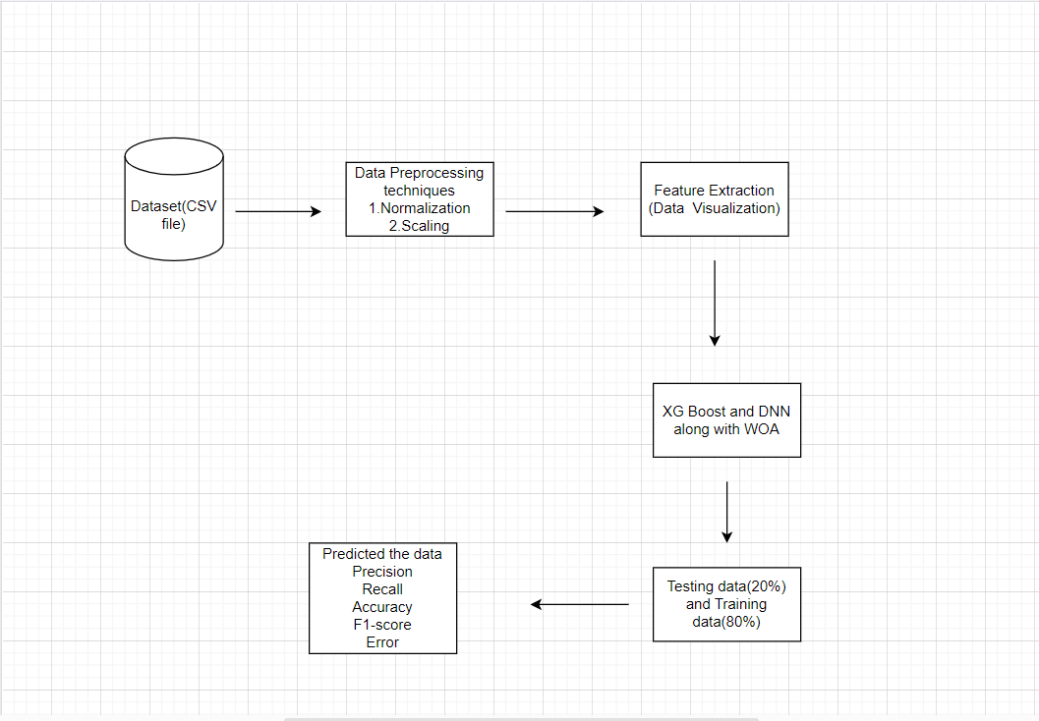
Work flow diagram

Slide 29
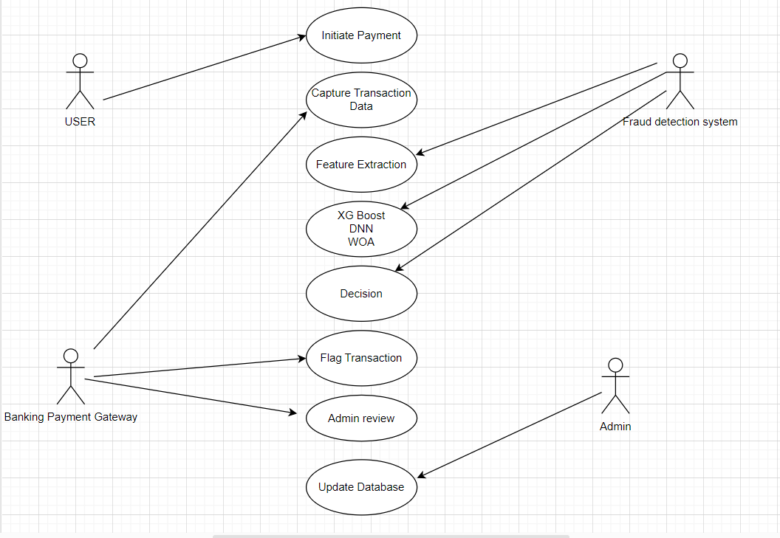
usecase diagram

Slide 30
CONTENTS
Abstract
Introduction
Literature Survey
Problem Statement
Objectives
Requirement Analysis
Identification of tools/technology/algorithms
Final Design Strategy (project workflow/ system design/ DFD/UML design)
Status of Implementation
Conclusion
Gantt Chart
References

Slide 31
Status of Implementation
Packages : pandas,numpy.
Libraries : sk learn,tensorflow,scikit learn,matplot lib.
Classes : train_test_split,classification_report,accuracy_score.
Methods : Whale Optimization, XG boost, DNN.

Slide 32
Objective 1: *Collect and Preprocess the Dataset 1. *Collect Dataset*: - Identify and source a reliable dataset for online payment fraud detection. Common datasets include: - Publicly available datasets like those on Kaggle (e.g., the UPI’s Fraud Detection dataset). - Private datasets from finance institutions or payment systems.
2.Explore and Understand the Data: - Load the dataset and examine its structure: - -Check the number of rows and columns. - --Understand feature descriptions (categorical vs. numerical). - Identify the target variable (fraudulent or not).

Slide 33
Dataset Information Before Preprocessing:
Number of Rows: 10,010
Number of Columns: 10
Column Names:
  Transaction ID
  Amount
  Time Since Last Transaction
  Location Match
  Device Match
  Transaction Channel
  Merchant Category
  User Age
  Account Tenure
  Fraud Label

Slide 34
Features:
Transaction ID: Unique identifier for each transaction (categorical, will be excluded during modeling).
Amount: Transaction amount (numeric).
Time Since Last Transaction: Time since the last transaction (numeric).
Location Match: Binary indicator if the transaction's location matches expected (0 or 1).
Device Match: Binary indicator if the device matches the user's usual device (0 or 1).
Transaction Channel: The channel used for the transaction (e.g., Mobile, Web).
Merchant Category: Type of merchant (categorical).
User Age: Age of the user (numeric).
Account Tenure: Length of time the account has been active (numeric).
Fraud Label: Target variable indicating whether the transaction was fraudulent (0 or 1)

Slide 35
Dataset After Preprocessing:
Load the Dataset
Load the dataset from the provided file.
Handle Missing Values
Check if there are any missing values.
If missing values exist:
  Fill missing values with the column median (or another strategy, like mean or mode).
Encode Categorical Features
Identify categorical columns (e.g., Transaction Channel, Merchant Category).
Convert these categorical columns into numerical format using encoding techniques (e.g., label encoding).
Normalize Numerical Features
Identify numerical columns (e.g., Amount, Time Since Last Transaction, User Age, Account Tenure).
Apply Min-Max Normalization to scale these features into the range [0, 1].
Scale Numerical Features
Use Standard Scaling to standardize numerical columns so they have:
  Mean = 0
  Standard Deviation = 1.
Save the Cleaned Dataset
Save the cleaned dataset to a new file (e.g., cleaned_dataset.csv).
Preview Cleaned Dataset
Print the first few rows of the cleaned dataset to verify the changes.

Slide 36
1.Normalization in Dataset Preprocessing and Collection
Normalization is a crucial data preprocessing step when working with machine learning models. It rescales data into a specific range (commonly [0, 1] or [-1, 1]) to ensure consistent feature magnitudes, which has direct implications for both dataset collection and preprocessing.
2. Scaling in Dataset Preprocessing
Scaling ensures that numerical features are standardized to a consistent range or distribution, which helps machine learning algorithms perform optimally.
Scaling Techniques in Preprocessing:
Min-Max Scaling: Normalizes data to a range [0, 1].

Slide 37
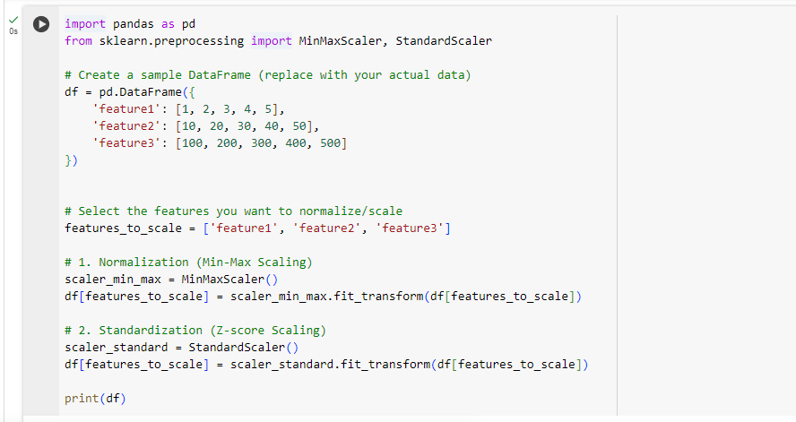
Normalization and Scaling

Slide 38
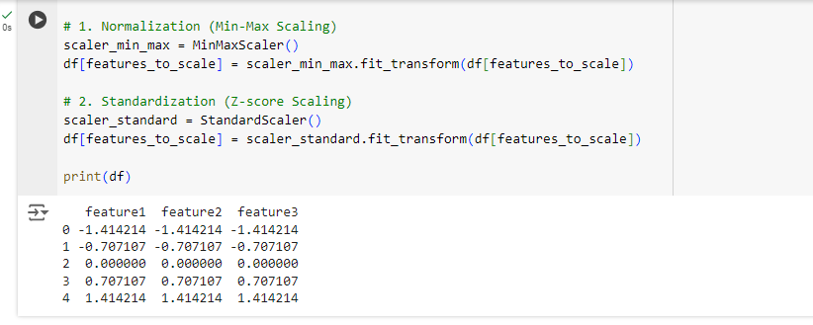
Output for Normalization & Scaling

Slide 39
No missing values: All null/missing entries will be filled.
Encoded categorical features: Categorical columns (e.g. Transaction channel) will be converted to numerical values.
Normalized numerical features: Numerical columns will be rescaled t range [0,1].
Standardized numerical features: Numerical columns will have a mean of 0 and standard deviation of 1.
Dataset link:
"C:\Users\91778\Downloads\augmented_online_payment_fraud_dataset.csv"

Slide 40
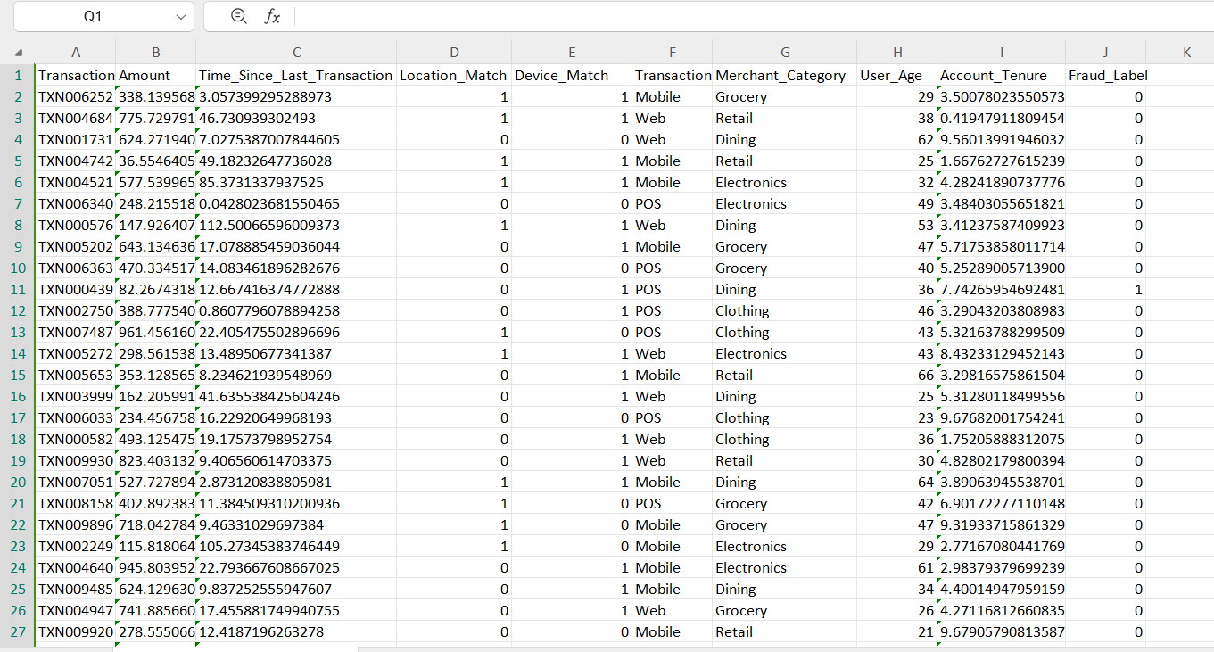
DATASET

Slide 41
Objective 2: Train the Model (XG Boost, DNN, and WOA)
Train XG Boost:
  Import XG Boost libraries.
  Set up the model:
    Define hyperparameters (learning rate, max depth, n-estimators, etc.).
  Train the model using the training dataset.
  Evaluate the model on the test set and record the performance metrics.
Develop DNN Model:
  Import libraries like TensorFlow .
  Build the network:
    Define input, hidden, and output layers

Slide 42
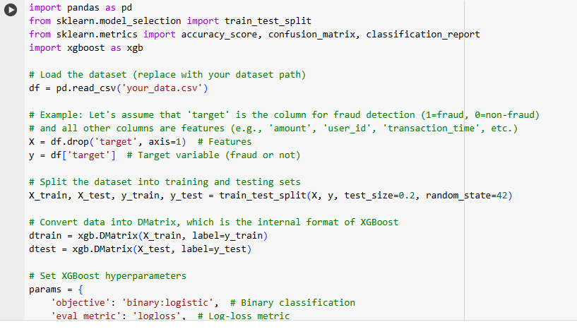
Implementation of XGBoost

Slide 43
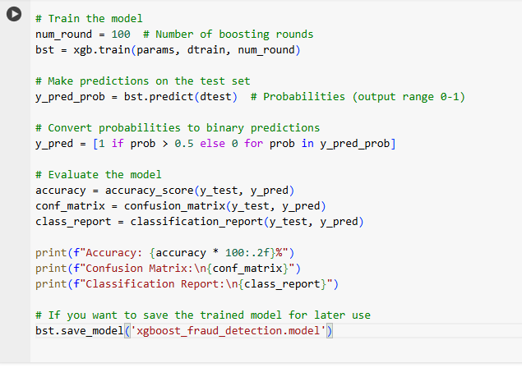
Train the model

Slide 44
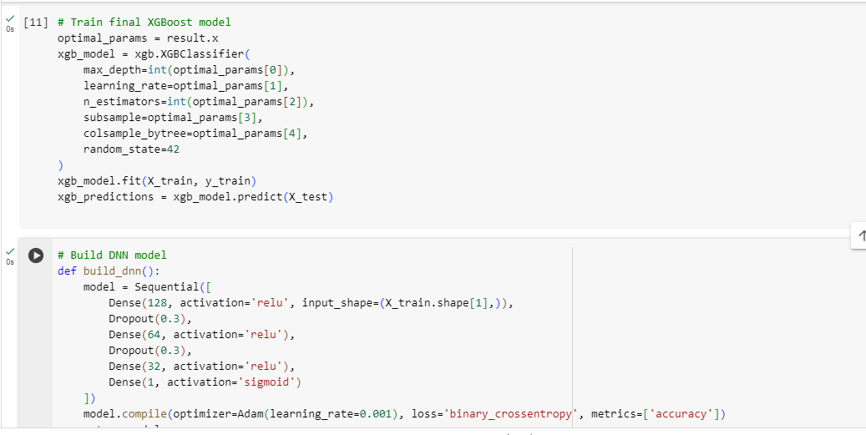
Develop DNN Model:

Slide 45
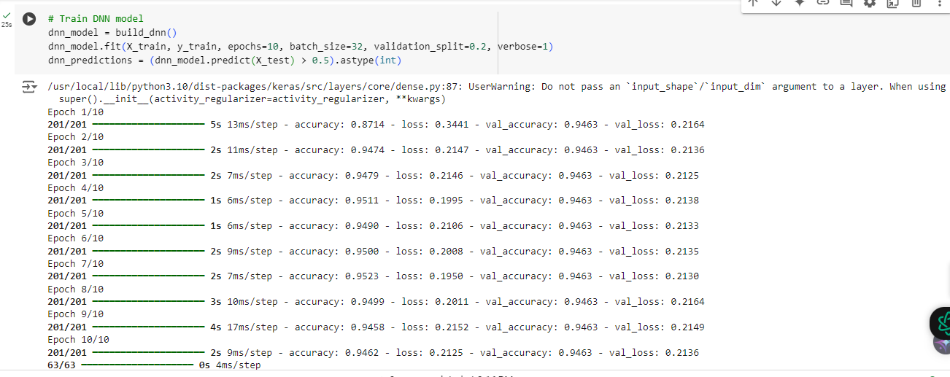
Train DNN Model

Slide 46
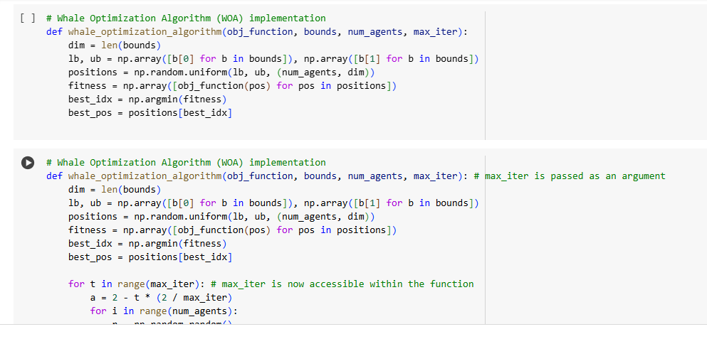
Whale Optimization Algorithm

Slide 47
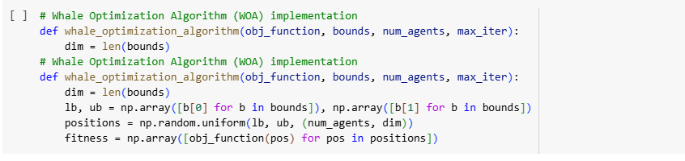
Implementation of WOA

Slide 48
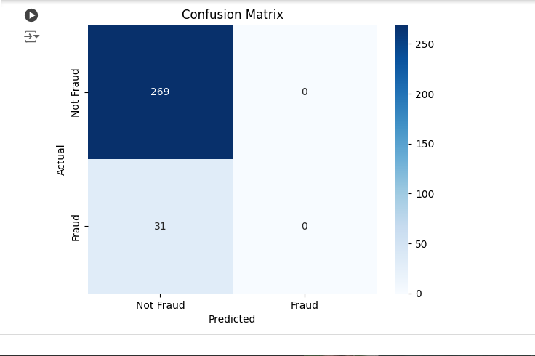
Confusion matrix

Slide 49
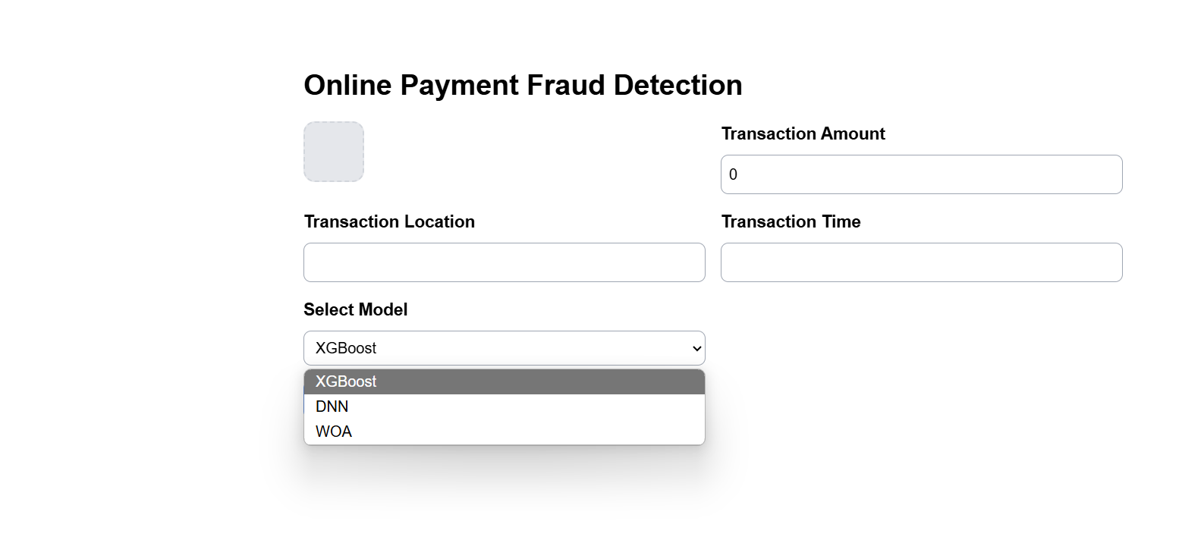
SAMPLE USER INTERFACE

Slide 50
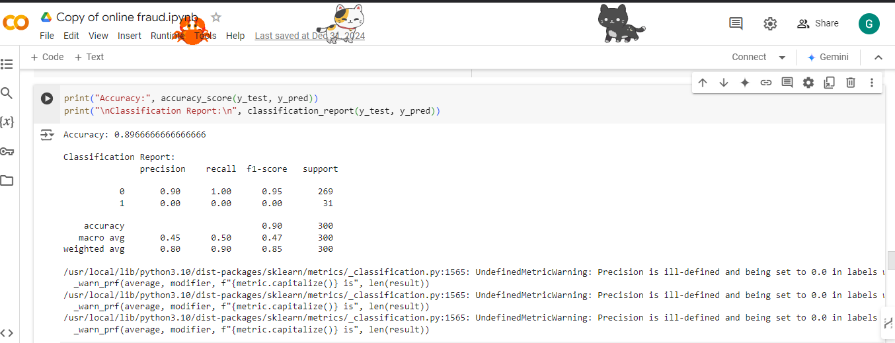
Status of Implementation
Accuracy and Classification report

Slide 51
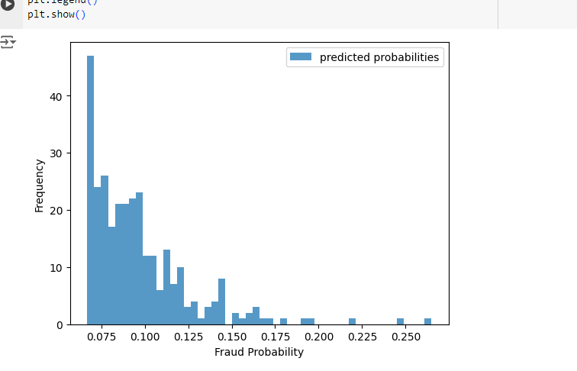
Status of Implementation
Fraud Probability Plotting

Slide 52
CONTENTS
Abstract
Introduction
Literature Survey
Problem Statement
Objectives
Requirement Analysis
Identification of tools/technology/algorithms
Final Design Strategy (project workflow/ system design/ DFD/UML design)
Status of Implementation
Conclusion
Gantt Chart
References

Slide 53
Conclusion
In this project, we developed a hybrid model for fraud detection in UPI (Unified Payments Interface) transactions using a combination of XG Boost, Deep Neural Networks (DNN), and the Whale Optimization Algorithm (WOA). The goal was to improve the accuracy and efficiency of fraud detection in online payments, particularly focusing on UPI, which has become one of the most widely used digital payment systems in India.

Slide 54
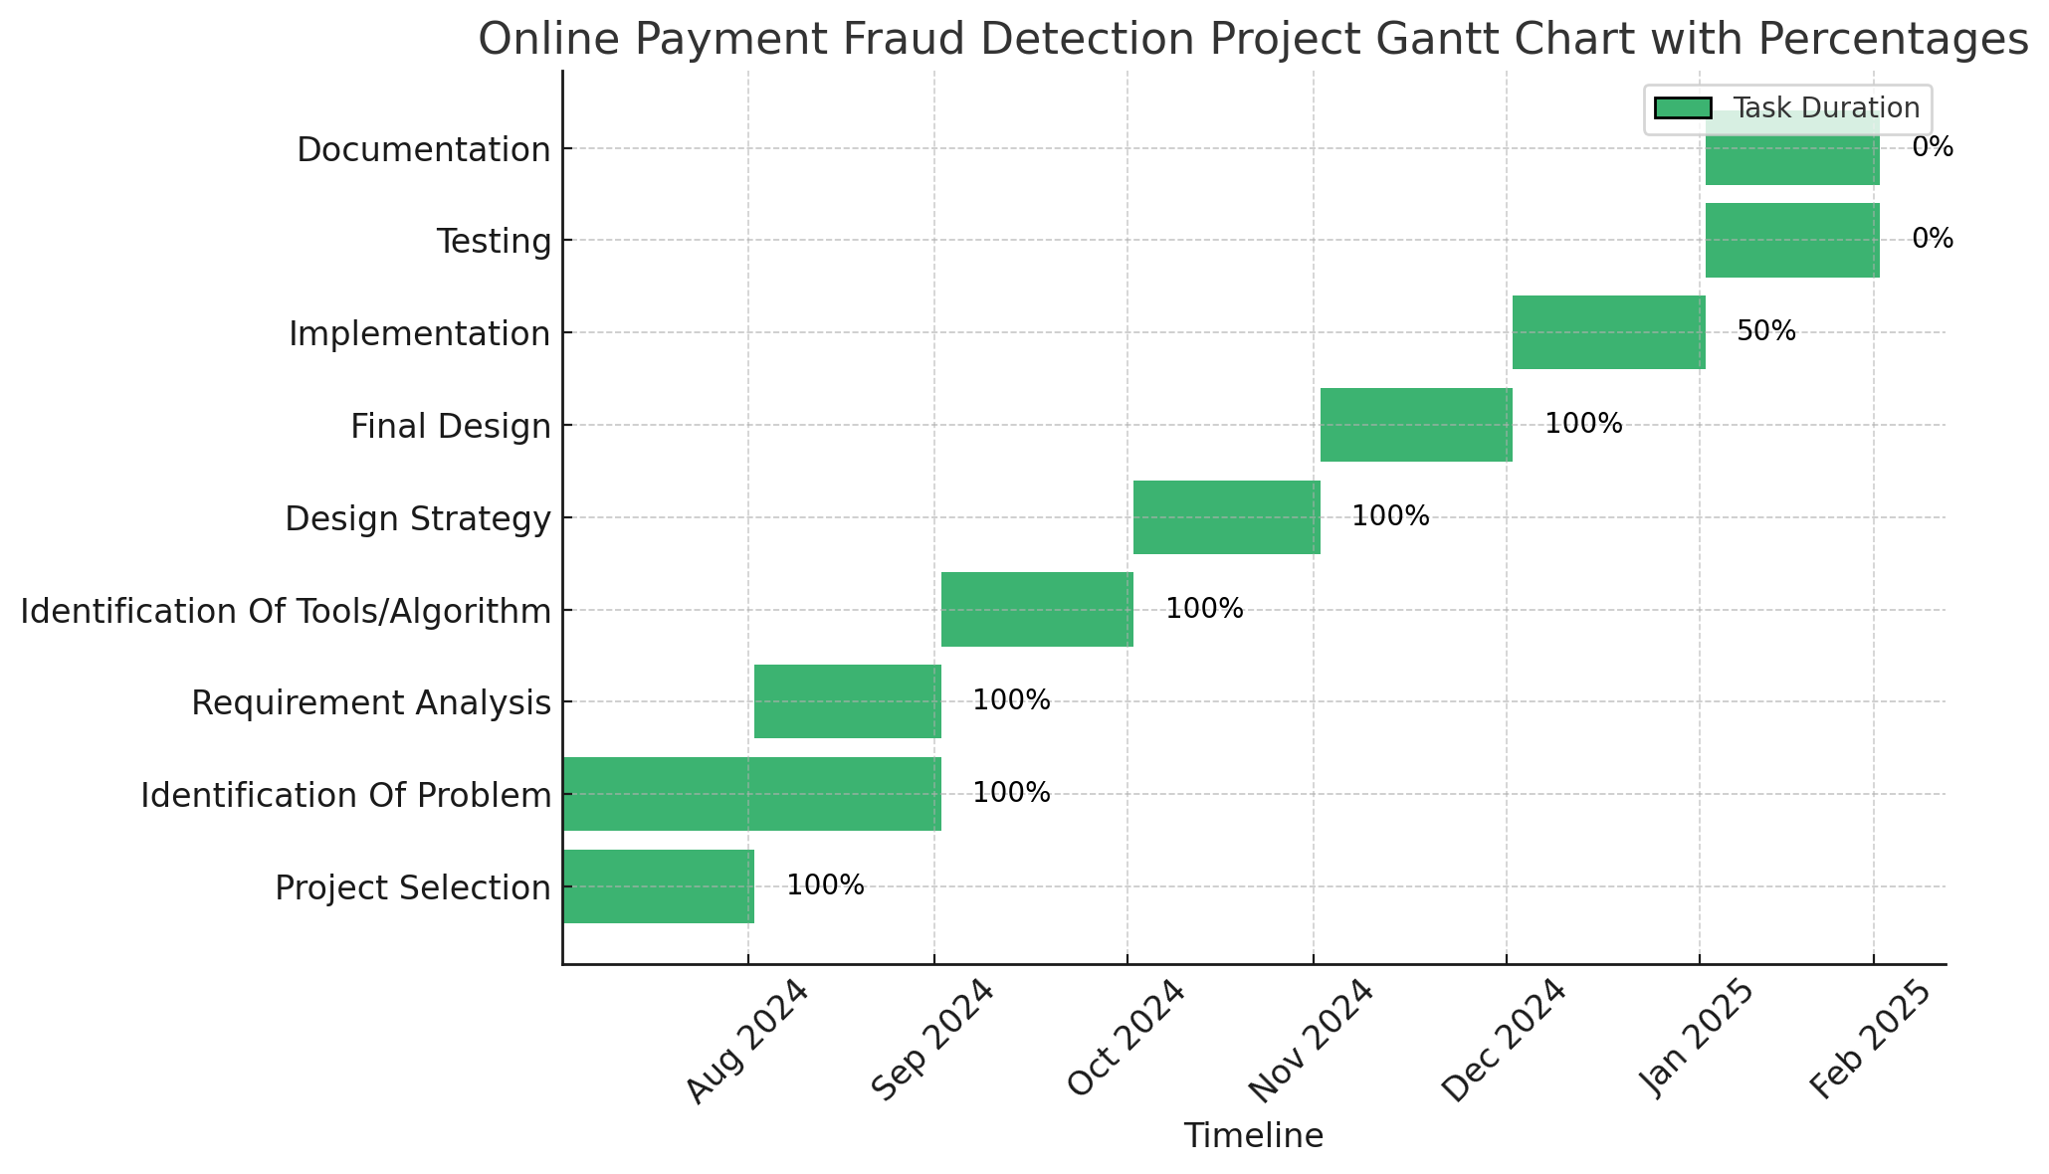
Gantt Chart

Slide 55
CONTENTS
Abstract
Introduction
Literature Survey
Problem Statement
Objectives
Requirement Analysis
Identification of tools/technology/algorithms
Final Design Strategy (project workflow/ system design/ DFD/UML design)
Status of Implementation
Conclusion
Gantt Chart
References

Slide 56
References
Journals
[1]l Hamoud, A., Hoenig, A. and Roy, K., 2022. Sentence subjectivity analysis of a political and ideological debate dataset using LSTM and BiLSTM with attention and GRU models. Journal of King Saud University-Computer and Information Sciences, 34(10), pp.7974-7987, 2022.
[2] Bouaziz, F., Oulhadj, H., Boutana, D. and Siarry, P., 2019. Automatic ECG arrhythmias classification scheme based on the conjoint use of the multi‐layer perceptron neural network and a new improved metaheuristic approach. IET Signal Processing, 13(8), pp.726-735.
[3] A. Varshney, R. Kolhe, S. Gatne and V. V. Ingale, "Arrhythmia Classification of ECG Signals Using Undecimated Discrete Wavelet Transform," 2022 IEEE 7th International conference for Convergence in Technology (I2CT), Mumbai, India, 2022, pp. 1-5.
[4] Babu, D.V., Karthikeyan, C. and Kumar, A., 2020, December. Performance analysis of cost and accuracy for whale swarm and RMSprop optimizer. In IOP Conference Series: Materials Science and Engineering (Vol. 993, No. 1, p. 012080). IOP Publishing.

